Slide 1
Interfaces
Part II
Dr. Phesto Namayala , 2024

Slide 2
Learning Objectives
At the end of this lecture, students must
Understand the meaning of object class, object methods, abstract classes, and interfaces.
Understand additional details of abstract methods

Slide 3
Object Class
Object class is the special class; all other classes are its sub-class.
Every class in Java is directly or indirectly derived from the Object class.
If a class does not extend any other class, then it is a direct child class of Object, and if it extends another class, then it is indirectly derived.
Object class is present in java.lang package.
Therefore, the Object class methods are available to all Java classes. Hence, the Object class is the root of the inheritance hierarchy in any Java Program.

Slide 4
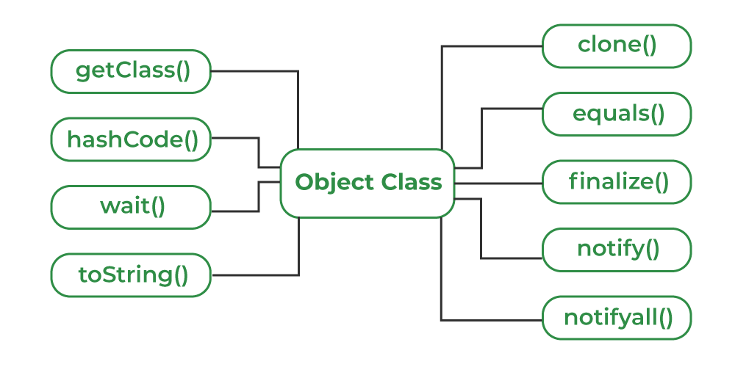
Using Object Class Methods..
The Object class provides multiple methods which are as follows:

Slide 5
Using Object Class Methods..
Method | Purpose
toString() | Provides a String representation of an object and is used to convert an object to a String.
hashCode() | It returns distinct integers for distinct objects.
equals(Object obj) | It compares the given object to “this” object (the object on which the method is called).
getClass() | It returns the class object of “this” object and is used to get the actual runtime class of the object.
finalize() | This method is called just before an object is garbage collected.
clone() | It returns a new object that is exactly the same as this object.

Slide 6
toString() Method
The default toString() method for class Object returns a string consisting of the name of the class of which the object is an instance, the at-sign character `@’, and the unsigned hexadecimal representation of the object’s hash code.
In Java programming it is defined as
public String toString()
{
return getClass().getName() + "@" + Integer.toHexString(hashCode());
}

Slide 7
toString() Method..
It is always recommended to override the toString() method to get our own String representation of Object.
Note: without overriding whenever we try to print any Object reference, the internal toString() method is called.
For example
Student s = new Student();
// Below two statements are equivalent
System.out.println(s);
System.out.println(s.toString());

Slide 8
hashCode() method
The hashCode() method is native because, in Java, it is impossible to find an object's address, so it uses native languages like C/C++ to do so.
It returns a hash value used to search objects in a collection.
JVM(Java Virtual Machine) uses the hashcode method while saving objects into hashing-related data structures like HashSet, HashMap, Hashtable, etc. The main advantage of saving objects based on hash code is that searching becomes easy.

Slide 9
hashCode() method..
Note: Override of hashCode() method needs to be done such that for every object we generate a unique number.
For example, for a Student class, we can return the roll no. of a student from the hashCode() method as it is unique.

Slide 10

hashCode() method..
// Java program to demonstrate working of
// hashCode() and toString()
public class Student {
static int last_roll = 100;
int roll_no;
// Constructor
Student()
{
roll_no = last_roll;
last_roll++;
}
// Overriding hashCode()
@Override public int hashCode() { return roll_no; }
// Driver code
public static void main(String args[])
{
Student s = new Student();
// Below two statements are equivalent
System.out.println(s);
System.out.println(s.toString());
}
}

Slide 11
equals(Object obj) method
It gives a generic way to compare objects for equality.
We should override the equals(Object obj) method to get our own equality condition on Objects.
Note: It is generally necessary to override the hashCode() method whenever this method is overridden, so as to maintain the general contract for the hashCode method, which states that equal objects must have equal hash codes.

Slide 12
getClass() method
It can also be used to get metadata of this class. The returned Class object is the object that is locked by static synchronized methods of the represented class.
As it is final, we don’t override it.
public class Test {
public static void main(String[] args)
{
Object obj = new String("GeeksForGeeks");
Class c = obj.getClass();
System.out.println("Class of Object obj is : "
+ c.getName());
}
}

Slide 13
finalize() method
We should override finalize() method to dispose of system resources, perform clean-up activities and minimize memory leaks.
For example, before destroying the Servlet objects web container, the finalize method is always called to perform the session's clean-up activities.
Note: The finalize method is called once on an object even though that object is eligible for garbage collection multiple times.

Slide 14
finalize() method..
// Java program to demonstrate working of finalize()
public class Test {
public static void main(String[] args)
{
Test t = new Test();
System.out.println(t.hashCode());
t = null;
// calling garbage collector
System.gc();
System.out.println("end");
}
@Override protected void finalize()
{
System.out.println("finalize method called");
}
}

Slide 15
ABSTRACT CLASS
A class declared with an abstract keyword is known as an abstract class in Java.
It can have abstract and non-abstract methods (method with body).
Abstraction hides the implementation details and only shows the user functionality.
Abstraction lets you focus on what the object does instead of how it does it.
It needs to be extended and its method implemented.
Example abstract class:
abstract class A{}

Slide 16
ABSTRACT CLASS ..
Abstract method is declared as abstract and does not have implementation. For example
abstract void printStatus();
//no body and abstract
In the example below, Shape is the abstract class, its implementation is provided by the Rectangle and Circle classes.
If you create the instance of Rectangle class, draw() method of Rectangle class will be invoked.

Slide 17
ABSTRACT CLASS ..
abstract class Shape{
Abstract void draw();
}
//In a real scenario, implementation is provided by others i.e. unknown by end user class Rectangle extends Shape{
void draw(){
System.out.println("drawing rectangle");
}
}
class Circle1 extends Shape{
void draw(){
System.out.println("drawing circle");
}
}
//In a real scenario, the method is called by a programmer or user class
TestAbstraction1{
public static void main(String args[]){
Shape s=new Circle1();
//In real scenario, object is provided through method e.g. getShape() method
s.draw();
}
}

Slide 18
ABSTRACT CLASS ..
An abstract class can have a data member, abstract method, method body, constructor, and even a main() method.
For example,
//example of an abstract class that has method body
abstract class Bike{
Bike(){
System.out.println("bike is created");
}
abstract void run();
void changeGear(){
System.out.println("gear changed");
}
}
class Honda extends Bike{
void run(){
System.out.println("running safely..");}
}
class TestAbstraction2{
public static void main(String args[]){
Bike obj = new Honda();
obj.run();
obj.changeGear();
}
}

Slide 19
ABSTRACT CLASS ..
The abstract class can also be used to implement the interface.
In such cases, the end user may not be forced to override all the interface methods.
interface A{
void a(); void b(); void c(); void d();
}
abstract class B implements A{
public void c(){System.out.println("I am c");}
}
class M extends B{
public void a(){System.out.println("I am a");}
public void b(){System.out.println("I am b");}
public void d(){System.out.println("I am d");}
}
class Test5{
public static void main(String args[]){
A a=new M();
a.a();
a.b();
a.c();
a.d();
}}

Slide 20
INTERFACE IN JAVA
An interface in Java is a blueprint of a class.
It has static constants and abstract methods.
The interface in Java provides a mechanism to achieve abstraction and multiple inheritance.
Interface is declared by using the interface keyword.
It provides total abstraction, which means all the methods in an interface are declared with an empty body and are public, and all fields are public, static, and final by default.
A class that implements the interface must implement all the methods declared in the interface

Slide 21
INTERFACE IN JAVA ..
Syntax:
interface <interface_name>
{
// declare constant fields
// declare methods that abstract
// by default.
}

Slide 22
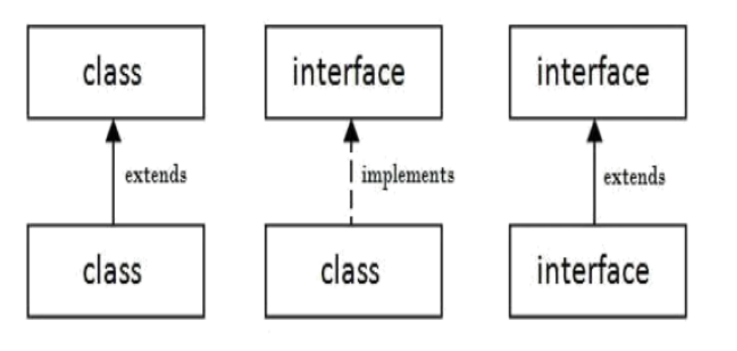
INTERFACE IN JAVA ..
Relationship between classes and interfaces

Slide 23
INTERFACE IN JAVA ..
Example 1.
interface printable{
void print();
}
class A6 implements printable{
public void print(){
System.out.println("Hello");
}
public static void main(String args[]){
A6 obj = new A6();
obj.print();
}
}

Slide 24
INTERFACE IN JAVA..
Example 2.
interface Drawable
{
void draw();
}
class Rectangle implements Drawable{
public void draw(){
System.out.println("drawing rectangle");}
}
class Circle implements Drawable{
public void draw(){
System.out.println("drawing circle");}
}
class TestInterface1{
public static void main(String args[]){
Drawable d=new Circle;
d.draw();
}
}

Slide 25
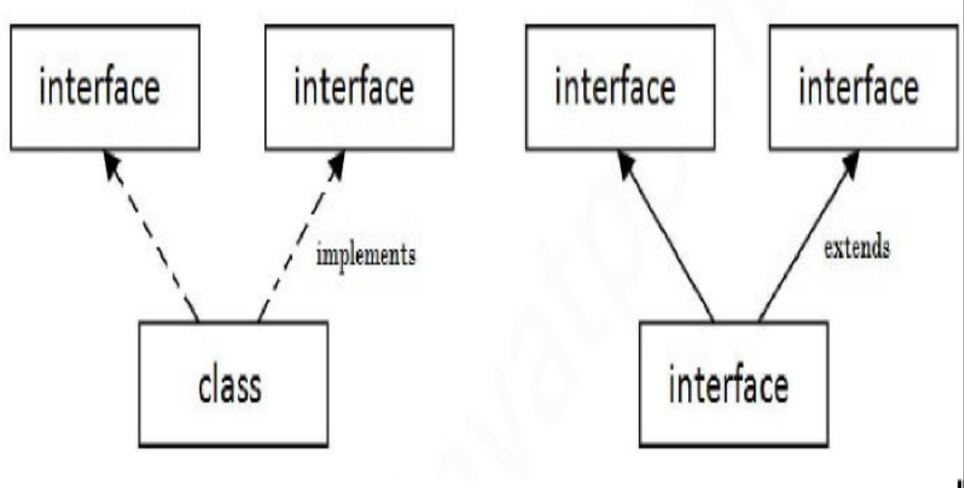
Multiple inheritance in Java by interface
If a class implements multiple interfaces or an interface extends multiple interfaces i.e. known as multiple inheritances.

Slide 26
Multiple inheritance in Java by interface..
interface Printable{
void print();
}
interface Showable{ void show();
}
class A7 implements Printable,Showable{
public void print(){
System.out.println("Hello");
}
public void show(){
System.out.println("Welcome");
}
public static void main(String args[]){
A7 obj = new A7();
obj.print();
obj.show();
}
}

Slide 27
Key points to remember about interfaces
We can’t instantiate an interface in Java. That means we cannot create the object of an interface
Interface provides full abstraction as none of its methods have a body. On the other hand abstract class provides partial abstraction as it can have abstract and concrete(methods with body) methods both.
The “implements” keyword is used by classes to implement an interface.
While providing an implementation in a class of any method of an interface, it needs to be mentioned as public.
Class that implements any interface must implement all the methods of that interface, else the class should be declared abstract.
Interface cannot be declared as private, protected, or transient.
All the interface methods are by default abstract and public.
Variables declared in the interface are public, static, and final by default.
interface Try
{
int a=10; public int a=10;
public static final int a=10; final int a=10;
static int a=0;
}

Slide 28
Key points to remember about interfaces ..
Interface variables must be initialized at the time of declaration; otherwise, the compiler will throw an error.
interface Try
{
int x;//Compile-time error
}
Inside any implementation class, you cannot change the variables declared in the interface because, by default, they are public, static, and final.
An interface can extend any interface but cannot implement it.
A class can implement any number of interfaces.

Slide 29
Key points to remember about interfaces ..
If two or more methods are the same in two interfaces and a class implements both interfaces, implementing the method once is enough.
A class cannot implement two interfaces with methods with the same name but different return types.
Variable name conflicts can be resolved by interface name.

Slide 30
Advantages of interface in java:
Without bothering about the implementation part, we can achieve the security of implementation
In Java, multiple inheritance is not allowed. However, you can use the interface to make use of it as you can implement more than one interface.

Slide 31
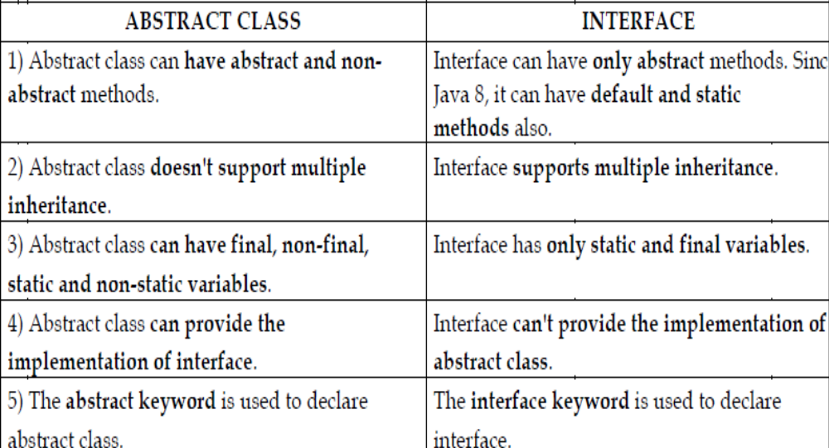
DIFFERENCE BETWEEN ABSTRACT CLASS AND INTERFACE

Slide 32
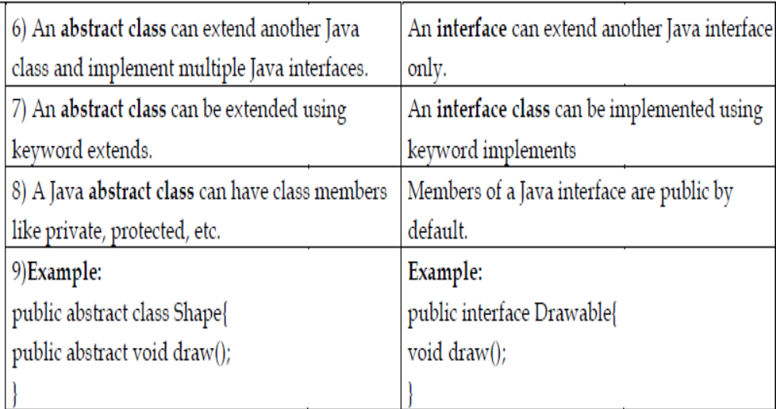
DIFFERENCE BETWEEN ABSTRACT CLASS AND INTERFACE

Slide 33
FINAL KEYWORD
Final keyword can be used along with variables, methods, and classes.
final variable - is a variable whose value cannot be changed at any time once assigned; it remains a constant forever.
final method - cannot be overridden;
final class - cannot be extended(cannot be subclassed),

Slide 34
Object Cloning
The object cloning is a way to create exact copy of an object.
The clone() method of Object class is used to clone an object.
The java.lang.Cloneable interface must be implemented by the class whose object clone we want to create.
Syntax of the clone() method:
protected Object clone() throws CloneNotSupportedException

Slide 35
Advantages and disadvantages of cloning
Advantages of cloning | Disadvantages of cloning
You don't need to write lengthy and repetitive codes. Use an abstract class with a 4- or 5-line long clone() method. | To use the Object.clone() method, we have to change a lot of syntaxes to our code, like implementing a Cloneable interface, defining the clone() method and handling CloneNotSupportedException, and finally, calling Object.clone() etc.
It is the easiest and most efficient way for copying objects, especially if we are applying it to an already developed or an old project. Just define a parent class, implement Cloneable in it, provide the definition of the clone() method and the task will be done. | We have to implement cloneable interface while it doesn?t have any methods in it. We just have to use it to tell the JVM that we can perform clone() on our object.  
Clone() is the fastest way to copy array. | Object.clone() is protected, so we have to provide our own clone() and indirectly call Object.clone() from it.

Slide 36
Advantages and disadvantages of cloning
Advantages | Disadvantages
 | Object.clone() doesn?t invoke any constructor so we don?t have any control over object construction.
 | If you want to write a clone method in a child class then all of its superclasses should define the clone() method in them or inherit it from another parent class. Otherwise, the super.clone() chain will fail.
 | Object.clone() supports only shallow copying but we will need to override it if we need deep cloning.

Slide 37
INNER CLASSES
Inner class means one class which is a member of another class.
There are four types of inner classes in Java.
  Nested Inner class - can access any private instance variable of the outer class.
  Method Local inner classes - Inner class can be declared within a method of an outer class.
  Anonymous inner classes - Anonymous inner classes are declared without names. They are created in two ways: As a subclass of a specified type and As implementers of the specified interface
  Static nested classes - Static nested classes are not technically inner classes. They are like a static member of the outer class

